Slide 1
Lipan High School Freshman
Guidance
2021 - 2022

Slide 2
COVID 19
I know the last two school years has been challenging and I will try my best to explain everything in this presentation.
I am just an email/phone call away.
We will get through this together.

Slide 3
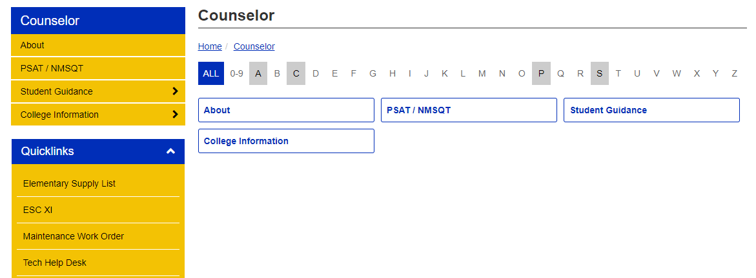
Use resources available
Remind texts/emails, LHS Website, & Facebook

Slide 4
Help your student focus on:
Good study habits
Maintain good attendance
Checking grades frequently
Talking with teachers
Staying for tutoring
Making positive choices
Becoming independent
Planning, meeting deadlines
Setting goals

Slide 5
Help get your student to check
Grades & Attendance

Slide 6
STAAR EOC Requirements
5 EOCs taken with corresponding courses
English 1 English 2
Algebra 1 Biology
U.S. History

Slide 7
Grade Classifications
Freshman 9th Grade 0 - 5.5 credits
Sophomore 10th Grade 6 credits
Junior 11th Grade 12 credits
Senior 12th Grade 18 credits

Slide 8
Graduation Plan
Requirements | Foundation High School Plan
English | 4
Math | 3*
 | *Two credits must consist of: - Algebra 1 - Geometry Endorsement requires a 4th math credit Algebra 2 required for Distinguished Level of Achievement

Slide 9
Foundation Plan
Science Requirements
3
Credits to include:
Biology
Chemistry, Physics, IPC or Advanced Science
*4th Science
* 3^{rd /} 4th Science – choose one
Physics
Advanced Animal Science
Environmental Science
Anatomy & Physiology
DC Biology
Endorsements require 4 Science credits

Slide 10
Foundation Plan
Social Studies Requirements
3
Credits to include:
1 World History
or World Geography*
1 U. S. History
½ U. S. Government
½ Economics
*A 4th History credit is required for a Multidisciplinary Endorsement.

Slide 11
Foundation Plan
Additional Requirements
Physical Education 1 credit
Foreign Language 2 credits
*Must be the same language
Fine Arts 1 credit
(Band, Floral Design, Dual Credit course)
Electives 5 credits

Slide 12
Foundation Plan
Total
Credits
Required
26
with endorsement

Slide 13
Foundation High School Plan
Endorsement: A pathway, an area of interest, following a sequence of courses
A student may earn an endorsement by successfully completing:
Curriculum requirements for the endorsement
Four credits in mathematics
Four credits in science
Two additional elective credits

Slide 14
Endorsements
Foundation Program in addition to one Endorsement is required for graduation.
LISD Offers All 5 Endorsements
Endorsements (Area of Interest)
STEM (5 credits of Math or Science or combination)
Business and Industry (AG, Computer/Technology)
Public Services (Human Services)
Arts and Humanities (4 credits of Band or Spanish)
Multidisciplinary Studies (General including 4 credits in all academic areas or 4 advanced courses)
Notes:
In addition to the 22 Foundation requirements, students must earn and endorsement. There are 5 areas and GISD offers them all.
We will go through a breakdown of all endorsement areas next.

Slide 15
Opportunities for Performance Acknowledgments:
A student may earn a performance acknowledgement in one or more of the following categories:
• AP test score of 3 or higher or Outstanding performance on the PSAT(Commended or higher) or ASPIRE (college ready on at least 2 of 4 subject tests) or the SAT (1250) or the ACT (28);
• 12 hours of college credit (College Grade of 3.0 or above) or Associate’s Degree
• Bilingualism (three years of a foreign language)
• Earning a nationally or internationally recognized business or industry certification or license12 dual credit hours with a grade earned of a 3.0 or earn an associate degree while in high school

Slide 16
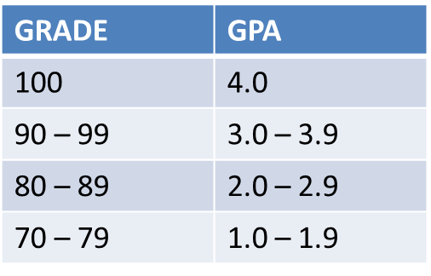
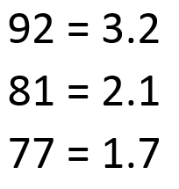
Information about GPA/Rank
Grade Point Averages are calculated based on final semester grades.
GPA and rank are figured at the end of the semester and year. See handbook for more information.
*A college GPA may vary
Examples:

Slide 17
Rank and G.P.A.
Students who graduate in the top 10% with a Distinguished Level of Achievement receive guaranteed admission to Texas public universities.
*except the University of Texas – top 6%
Grade Point Average (GPA) will be calculated on a 4.0 scale for all students.

Slide 18
Weighted grade average
Selected high-rigor classes are Advanced Placement or dual credit.
All students are eligible to enroll in the advanced courses. They may pick and choose courses appropriately with the guidance of counselors and parents.
Students who enroll in Honors (Pre-AP) courses will have 5 points added to their final semester grade.
Students who enroll in Advanced Placement or dual credit courses will have 10 points added to their final semester grade.
The full policy EIC (LOCAL) is available on the district website at www.lipanindians.net

Slide 19
College Credit Opportunities
Advanced Placement (ENG 4 AP is only option)
Subject test at the end of each school year scored on a scale of 1 – 5. AP credit is accepted by colleges nationwide. Price is $100 per test (financial assistance may be available).
Dual Credit
Must meet requirements to participate. Credit will apply to both the high school and college transcripts. Dual credit does not transfer to every school. Price is around $250 per course with possible book or lab fees. Financial assistance is available for free/reduced lunch.

Slide 20
Dual Credit
Please be aware that your child’s
high school grade and college grade may be different.
Check Parent Portal for LISD and check portal for Ranger College.

Slide 21
Dual Credit Registration
Students who are currently in dual credit must register with Mrs. Tuggle and pay Ranger College for each semester of classes.
Students and parents need to review options and choose appropriately for varying degree plans.
Registration application, forms, and taking the TSI Assessment is required.
TSI will be given at LHS on Tues, June 8th at 8:30 am or 1 pm. See a google form on Mrs. Tuggle’s website. $5 Fee

Slide 22
Testing Opportunities
STAAR - STAAR Tests
~ Major component of graduation
~ 5 EOC assessments will be required
PSAT - Eligible for scholarships during junior year
ACT - College admissions test
SAT - College admissions test
ASVAB - Interest and abilities assessment given by the
military
TSI - Texas Success Initiative – College
placement tests; required for Dual Credit courses

Slide 23
Time to start thinking ahead:
Advanced Academic Courses
GPA Calculation
Top 10%
FAFSA
Military Careers
Technical Colleges
Associate’s Degree/Bachelor’s Degree
Industry Certification of Licensure
College Visit (each student is allowed 2 excused days their junior & senior year)

Slide 24
Thank you for viewing!
Please complete the following form to complete your course registration process:
https://bit.ly/3un2YRc
Class of 2025

